Slide 1

What is RPA? Robotic Process Automation
Workshop
David.Wright@Kofax.com
Partner Development Manager
Notes:
Winning the Customer in the Cognitive/AI/RPA World.
Session Goals :Understand and articulate the value of focusing on human performance rather than machine performance in RPA & CDA opportunities.
Various Case Studies to make the problem very clear.

Slide 2

Notes:
Is your understanding of RPA stuck in the 1980’s with robots coming to take your job?
The Terminator movies of 1984 and 1991 personified the risk of AI as terminator robots intent on killing humans, so the humans rebelled. The “AI Skynet” they were talking about then was actually just a database: the SQL database was entering into the business world – data was being digitized. No-one fears a database today more than 30 years later. The AI fears of today will not concern our children.

Slide 3


Notes:
RPA is really about enhancing not replacing human performance. Do not try to remove people. You want people to do smart, creative tasks in a process. Only automate what a human doesn’t want to do.
This photo is part of a series about robots and humans interacting – but this photo is special, because the robot is working for the human in a passive way. The human is in full control – this is Kofax’ model of human-robot cooperation.
This image is common on the internet.
It can be found here https://www.gettyimages.at/detail/foto/robot-and-businesswoman-using-computer-stock-fotografie/529301356
The earliest reference I find of it is http://carlibux.blogspot.com/2010/12/human-vs-robot.html. There is a question from me 6 Sep, 2013 asking for the owner, with no reply.

Slide 4

Notes:
https://www.shutterstock.com/image-photo/concentrated-confident-mature-man-working-android-662279113
#

Slide 5
What is Robotic Process Automation (RPA)?

Slide 6
The three steps of a robot
GET CHANGE PUT

Slide 7
What is RPA?
“Automation of manual, routine and repetitive data entry tasks”
Gartner says true RPA includes desktop automation
Non-intelligent transfer of data
Business process that doesn’t need thinking

Slide 8


What is Robotic Process Automation (RPA)?
“
Robotic process automation (RPA) is the application of technology that automates workflow processes, primarily for administrative work. RPA software can help automate large volumes of digital manual-processing work.”
“
Robotic process automation (RPA) is the application of technology that allows employees in a company to configure computer software or a ‘robot’ to capture and interpret existing applications for processing a transaction, manipulating data, triggering responses and communicating with other digital systems.”
Notes:
Robots do the work of people
The solution to the problem is what we analyst call robotic process automation.
Robotic Process Automation employs software robots, which are better described as integration flows.
These robots include powerful, dynamic process flows that provide tangible integration and automation capabilities.
They mimic specific actions people take when interacting with web applications, web sites, portals, Excel worksheets, legacy green-screen apps, and email.

Slide 9

A Process
30
35
40
25
130
Notes:
Each person can process 25 boxes by themselves. So 4 people can process 100 boxes together. This is a process

Slide 10
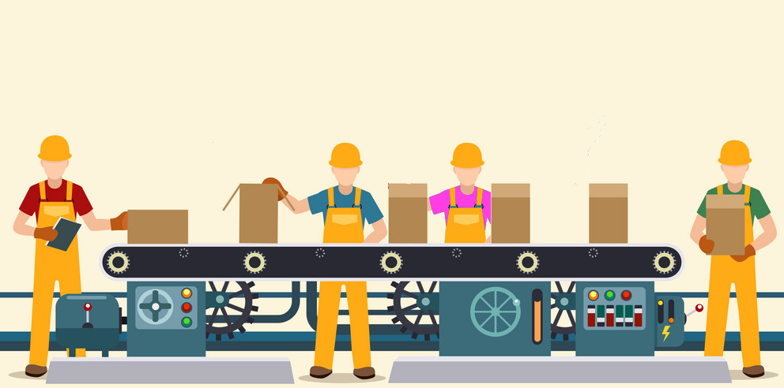
Process Automation
190
200
210
220
190
Notes:
When you separate tasks so that each person does something different, the 4 people can process 200 boxes together. This is process automation.

Slide 11
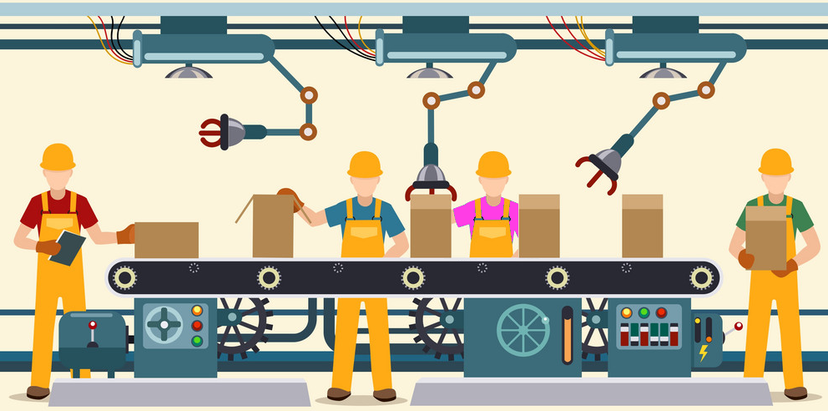
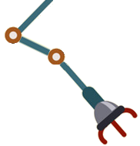



Robotic Process Automation
360
400
320
300
380
320
390
290
305
360
400
4000
400
Notes:
Add 3 robots. 4 people can now process 300 boxes. This is robotic process automation. The humans are assisted by robots.
It doesn’t make sense to say that 3 robots process 100 boxes. It doesn’t actually matter what the robots do. It makes sense that the people process 400 boxes with the help of robots.
If robot#2 can shut 200 boxes does that actually mean anything?
The value of the 3 robots is +100 boxes or +33%. By measuring the humans we know the PRECISE VALUE of the robots, and can calculate accurately the ROI of the robots.
But it gets better. We can ask the question “How do we get better than 300 boxes?”
Now we are open to many choices. We can score them all on human improvement and then implement the solution that gives the most value.
Add another robot
Make blue and purple person swap place.
Give green a table.
Red should stop using a clipboard.

Slide 12
Why RPA?

Slide 13
Why RPA?
Because we can. “Business Software”
Higher productivity, security, quality, drive down costs
Improve life quality and make people happier
Avoid human suffering, by securing processes
Expectations of the “Smart Phone” generation. Social Media
IT is overloaded and takes too long.
A lot of business data is in the cloud.
The customer doesn’t come to us anymore, we have to go to them
Explosion of Information.

Slide 14
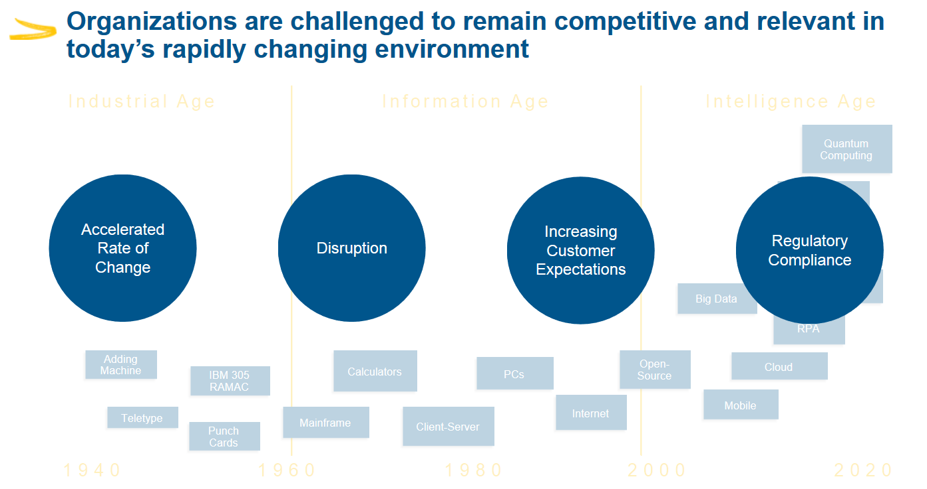

Slide 15
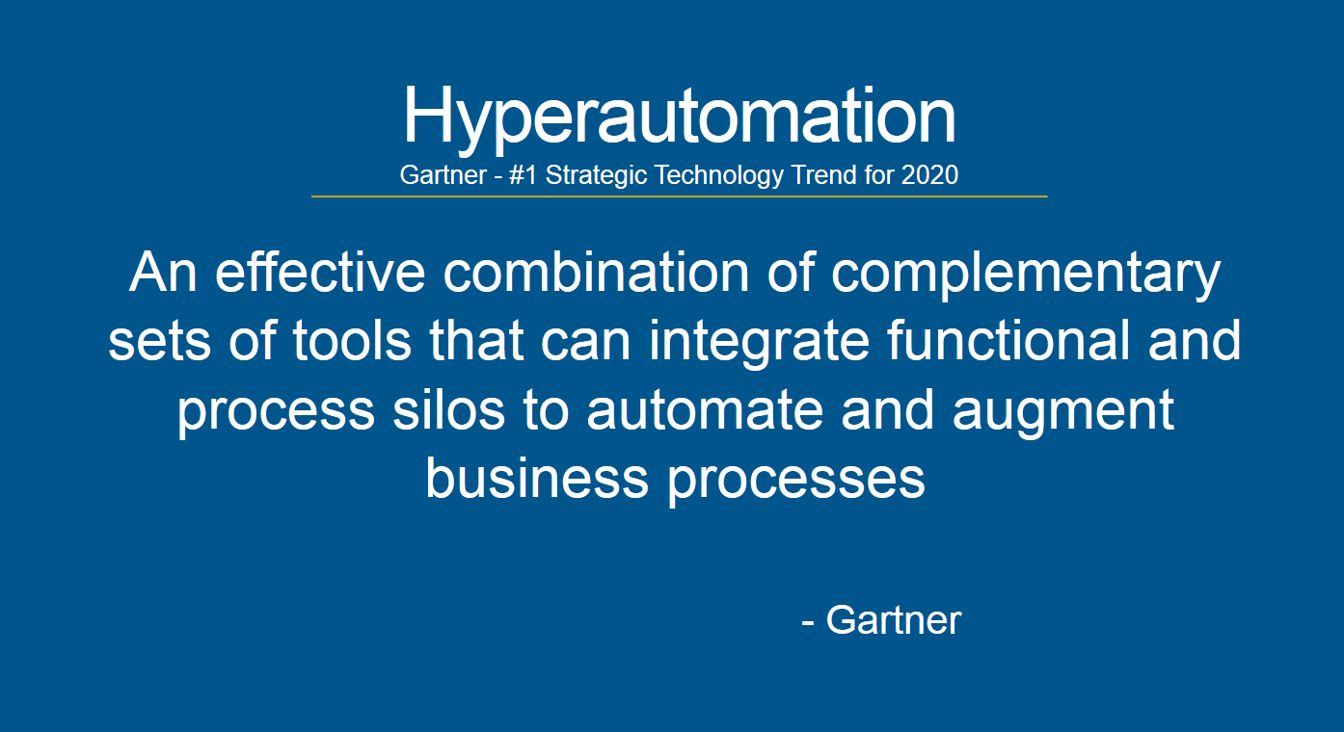

Slide 16
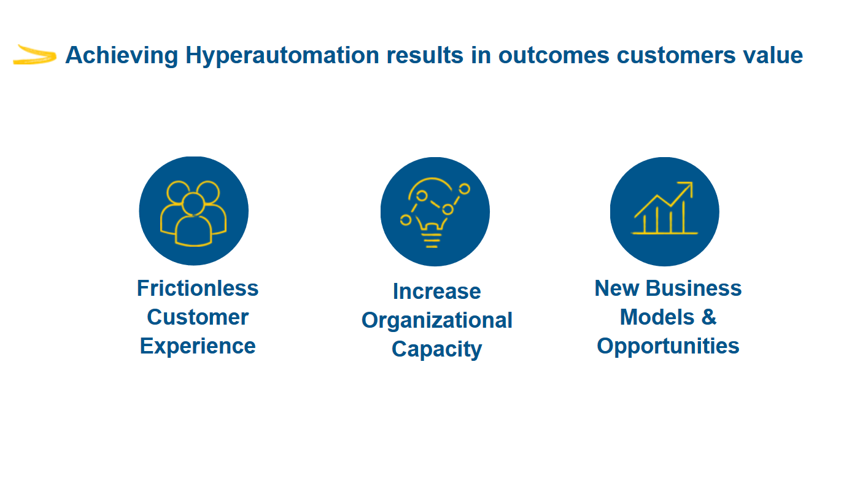

Slide 17
Intelligent Automation can be viewed as the next generation RPA solution that adds ‘judgement’ and ‘learning’ to simple RPA automation
Kofax
Artificial
Intelligence
Intelligent
Automation
Mimics human actions and decision-making using advanced technologies to understand environments and improve outcomes while creating the AI Digital Worker
Robotic Process
Automation
Value
Scripts / Macros
Augments human judgment and decision making by combining machine learning and automation to create smart Digital Workers
Automates rules-based tasks across multiple applications to create a Digital Worker
Automates rules-based tasks within a single application
1980s
2005
2018
?
Automation Capability
Notes:
On this slide, this is basically saying that we have a portfolio of products. Some of those products cater to legacy markets that aren’t growing, and then we have other portfolio products, RPA, that happen to be in markets that are growing parabolically. So what is the right balance between catering to legacy vs. hype markets.
If you look at RPA it is a point solution, and almost the gateway to a much larger market, that is intelligent automation. Being able to bring together multiple Kofax products to build an intelligent automation platform is where we think there is opportunity to deliver greater value to customers. The intelligent automation market is also a much larger market; some of the analyst groups are pegging it at 15x the size of PRA. Kofax already has a lot of the capabilities that other companies are going to have to buy, co-sell, OEM, or otherwise find externally to competitively play within the intelligent automation space. In that regards, Kofax has a huge competitive advantage here.

Slide 18
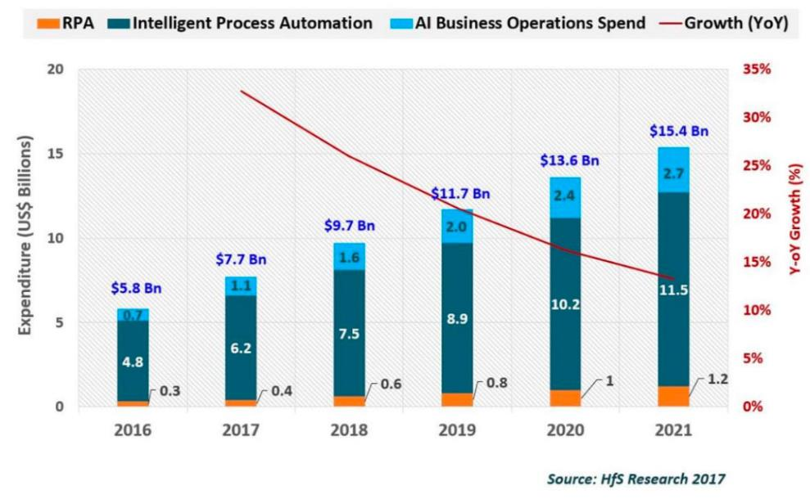
Kofax will be a differentiated leader in a ~$15B Intelligent Automation (IA) global market
Differentiators:
More platform capabilities than any other provider resulting in greater client ROI due to more end-to-end business processes automation
Pre-built solutions for key markets (KYC-AML, AP/IP, Onboarding, RPA, etc.)
Only platform to connect CIO SDLC and Business-Side COE
Competitors ‘build’ digital workers, Kofax will create a purpose-built Digital Workforce Management platform focused on ‘building & managing’ (RPA bots, chatbots, AI engines, open source ML, CDA, etc.)
Kofax will use the hype around the Intelligent Automation market to become the ‘connective tissue’ platform provider of digital solutions
18

Slide 19
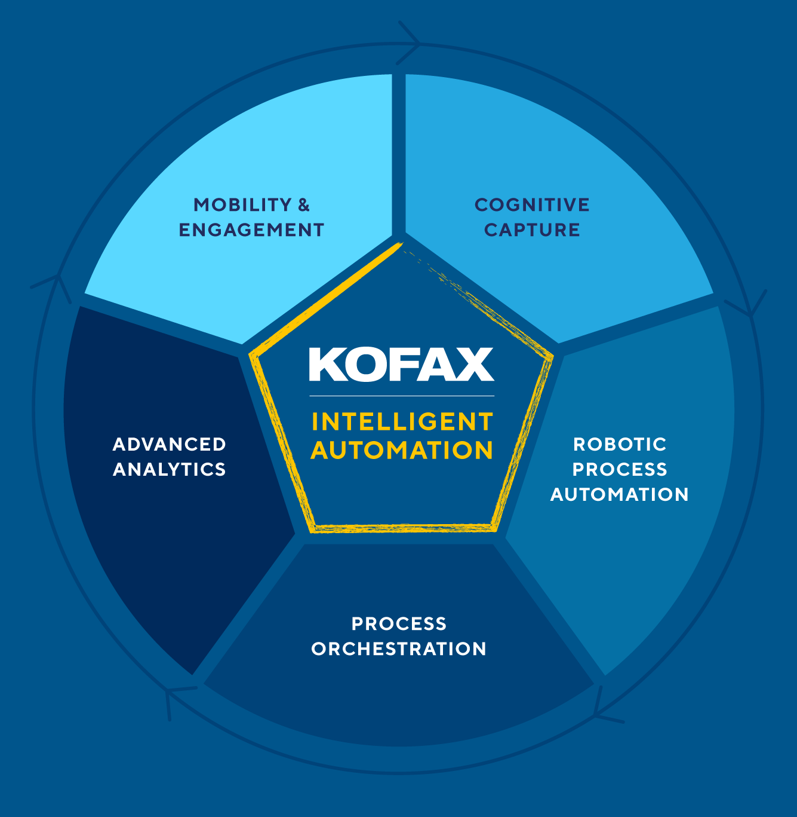
Kofax Intelligent Automation – Five unified capabilities
MOBILITY & ENGAGEMENT
Communicate and transact in efficient, effective, and trusted ways with e-signature, facial recognition and on-demand communications
COGNITIVE CAPTURE
Ingest & understand any document and its information via any ingestion channel and in any format with capture and cognitive document automation
ROBOTIC PROCESS AUTOMATION
Automate repetitive tasks with a digital workforce of attended and unattended software robots
PROCESS ORCHESTRATION
Drive successful outcomes by orchestrating multiple actions, people, software robots, policies & systems
ADVANCED ANALYTICS
Provide actionable analytics for any business process with increased visibility and deeper insights
Notes:
Each of the 5 capabilities of the Kofax Intelligent Automation platform are summarized here.
[read round if needed]
I want to emphasis that an additional capability of the platform is that we have invested to ensure that these capabilities work well together – that’s what we mean by “unified”.
You need these capabilities to be unified, so we’ve done this on your behalf.

Slide 20
Understand the Customer

Slide 21
Customer Engagement
Customer Analysis
Corporate Vision of CEO, Board
Goals of CxO
Needs of Department
Pains of workers
Notes:
Write down the corporate vision and mission statement. What are the CEO’s plans for the next year? Read the website. If the company is publically listed in the USA, read the business risks in their SEC quarterly reports.
Expect your sales colleagues to have done this deep analyse and be able to itemize and prioritize the goals, needs and pains.

Slide 22
Customer Qualification
(Executive) Vision – why the company exists, purpose, mission
Simplify, best in field, best services, innovate, sustainability, social responsibility
What is the corporate vision on the website?
(Operational) Goals - what they want to do
Improving speed, quality, service, growth, efficiency, market position, trust, creative,
“Automate”, transparency, customer satisfaction, prioritize
Save money, create value
(Departmental) Needs - what they need to do to achieve a goal
Comply, digitize, migrate, simplify, integrate, secure, retrieve, uptime, track, coordinate, streamline, “touchless”, measure …, keep employees happy and content, failure is not an option. Accuracy (quality of data), tracking, time frames, creative, error handling, productivity
(Departmental) Pains - prevents them from reaching a goal.
What happens if we do nothing at all?
Slow, intransparent, lost, wrong, complaints, increasing costs, complex, wasteful, no resources, insecure data, time consuming, tedious
Bold = RPA
Notes:
Who’s job is this?? The Account Manager! Not the Sales Engineer!

Slide 23



Meet the buyers
Business
VP Operations (line of business), Chief Operating Officer, Chief Data Officer, VP Data Research, Global Process Owner, Director of Process Management, Director/VP of Shared Services, Director of Operational Excellence
Technical
VP/Director of IT, VP/Director of RPA Services
Influencer
CIO, Compliance Officer, Data Research Analyst, Operations Manager

Slide 24
Use Cases

Slide 25
Kofax Standard Use Cases
Customer Due Diligence (CDD)
Equity Research Automation
Web Data Extraction
Automating Manual Finance Tasks (RPA for FPA)

Slide 26
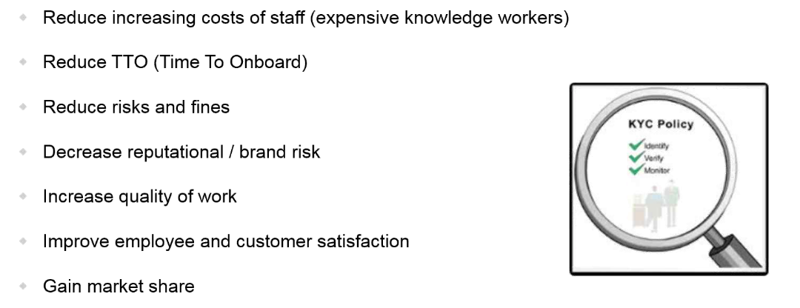
CDD Business Drivers (Customer Due Diligence)

Slide 27
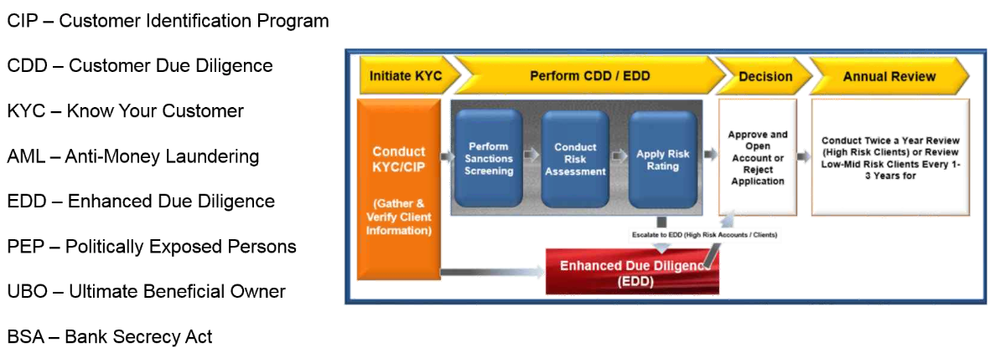
CDD, KYC, AML, EDD?

Slide 28
RPA for FPA (Financial Process Automation)
Vendor Master Data
Customer Master Record. Check credit rating
Journal Entry Correction (as part of month-end close activities)
Creation of assets (or change of asset/depreciation of asset)
Creation of payment proposal, extract report and issue email to Manager for payment proposal approval
Run, extract & email Balance sheet statements (as part of month-end activities)
Tax ID, Company Number, IBAN checking

Slide 29
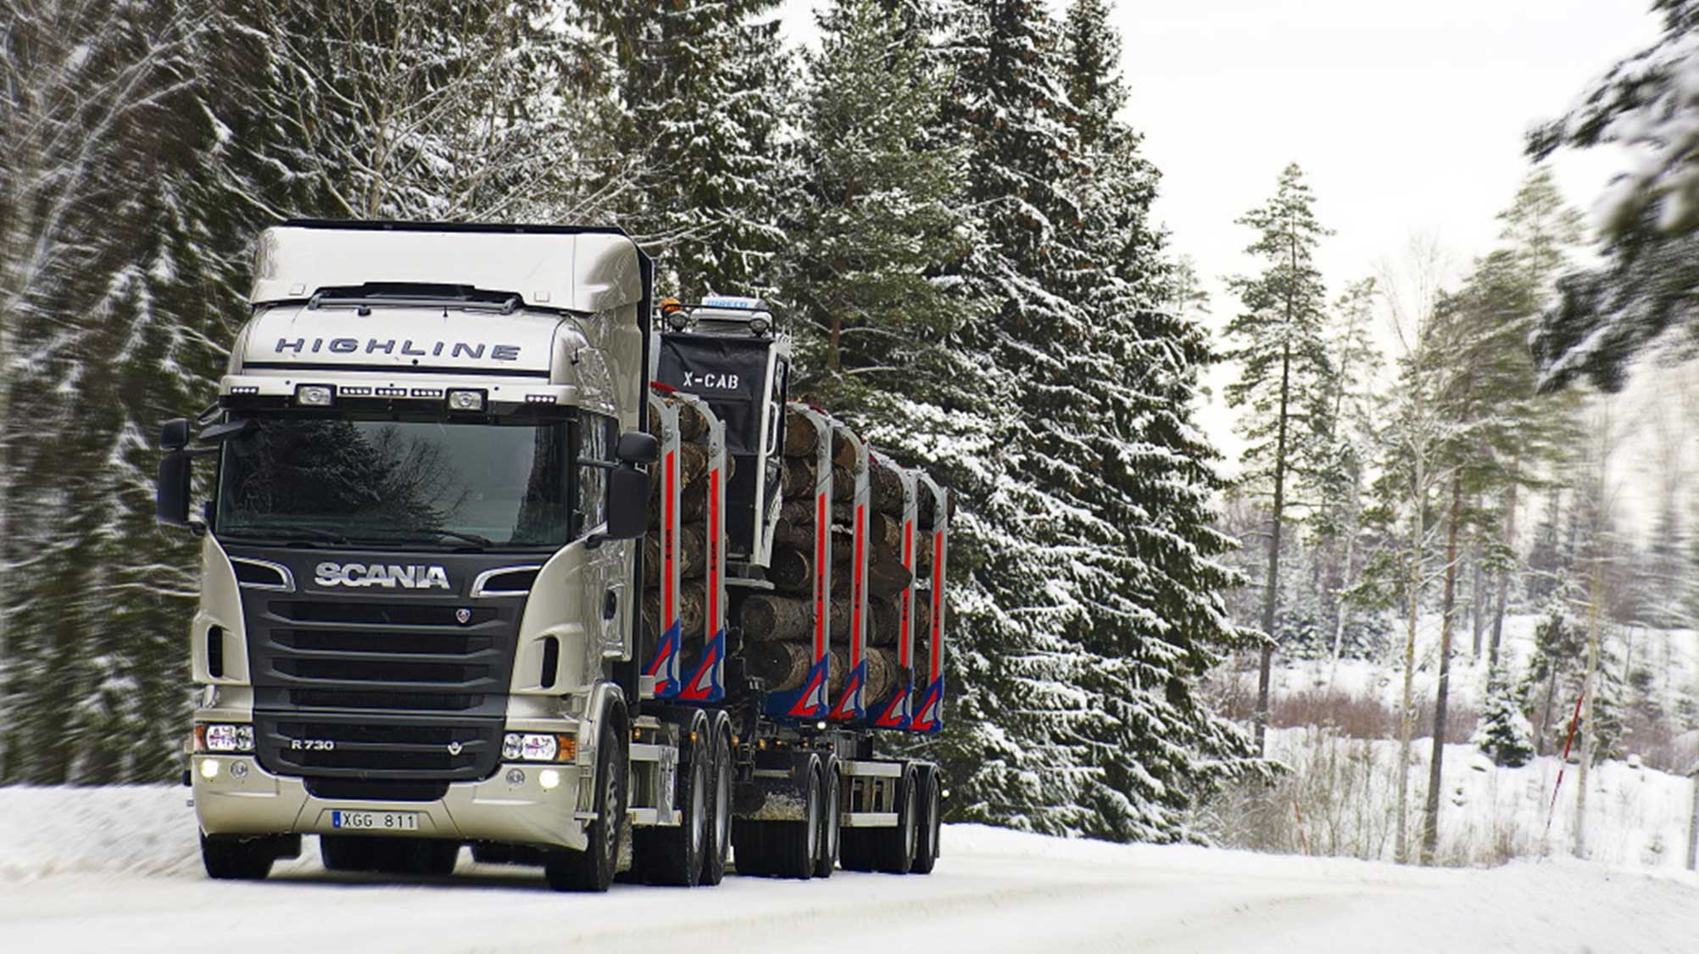

Slide 30
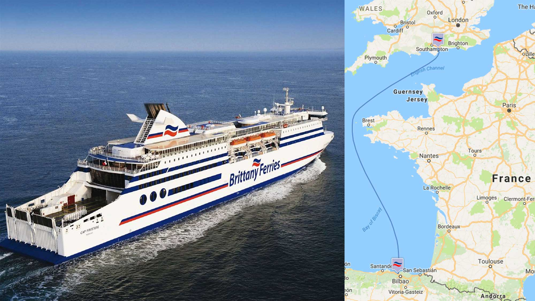

Slide 31
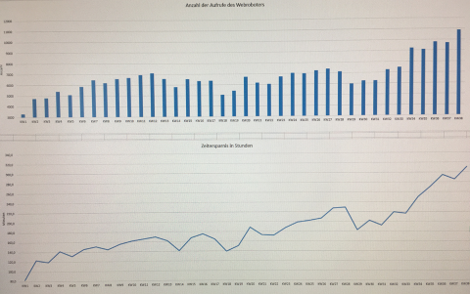

Slide 32
User Story – Logistics in Europe
P has worked at a logistics and transport company in Central Europe with 2B€ annual revenue and nearly 2000 employees for more than 11 years. After 16 months P and a colleague have built robots that save 200 hours per week (more than 5 people) and perform 7000 robot runs per week.
The company bought a Kofax RPA license in January 2017 along with 24 days of Professional Services from Kofax.
P was asked to be the robot developer because of his 10 years of experience in the business of Transport Management. He completely Kofax RPA training, had two visits from Sales Engineer Robert Birkenheuer and David Wright from Partner Development and then in the space of a few months had built robots that were doing the work of 2.3 people. His team had decided to measure the robots on the minutes they saved people. When a robot is built the workers are asked how many minutes of effort the robot will save them. This time saving metric is still reported on weekly by the RPA team to justify their work.
After two months of building robots excitement spread throughout the organization and Kofax was invited back to talk with the Finance, HR and logistics departments on how they can discover and evaluate internal processes for suitability for automation.
P was moved from the transport management department to the IT department so that he could focus on building the robots. A colleague R from the business interviews colleagues to find processes to automate.

Slide 33
User Story – Logistics in Europe (Continued)
P built robots to handle booking loading bays at warehouses, calculating the number of loads needed, loading/unloading status, accounting, buying ferry tickets, preparing responses to orders, calculating demurrage (charges paid for delayed loading/unloading) by connecting to 170 different web portals across Europe.
Due to P’s success and because the CIO and CTO wanted more robots, T joined the team in March 2018 and within a month had learnt from P how to build robots and both were confident enough for T to put his own robots into production. Together they have built 180 robots and there are a further outstanding 100 requests for robots. R, P & T together still have the freedom to decide which robots they will work on next. If a new robot idea comes along that is of very high value then they will prioritize that robot.
They have one Roboserver for production and one for testing. The robots generate 30-60 errors per week, mostly due to human errors, and this takes them about one hour per week to manage. Most of their robots are called directly by the data management software https://www.lobster.de as a REST service and some run on schedules.
Neither P or T are developers, nor Excel users, though T has experience in HTML. When they get stuck they call on Sascha from Kofax PS in Germany who helps them remotely.
P & T both really enjoy building robots and are looking forward to building many more for their company. They are planning to upgrade to Kofax RPA 10.3 and then embark on building device automation robots. They have demonstrated well that a very small team can do very effective work by themselves building robots without any background in software development.

Slide 34
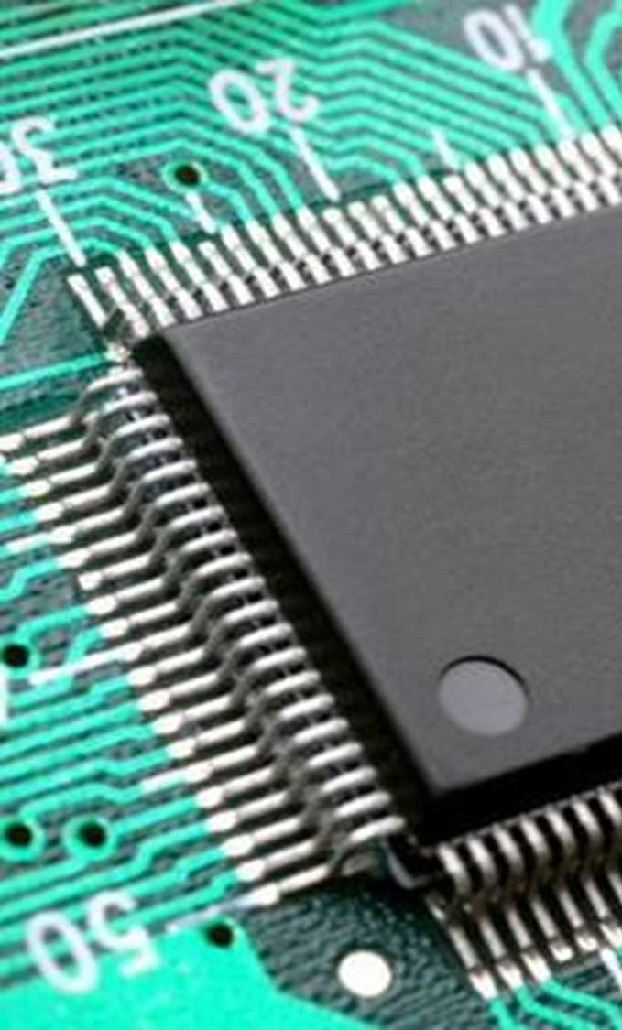
Semiconductor Producer USA
Case Study
Tracking 6000 products on websites
Does the work of 10-15 people
Notes:
Semiconductor producer USA
The robots saved 10-15 people efforts. 6000 products.

Slide 35
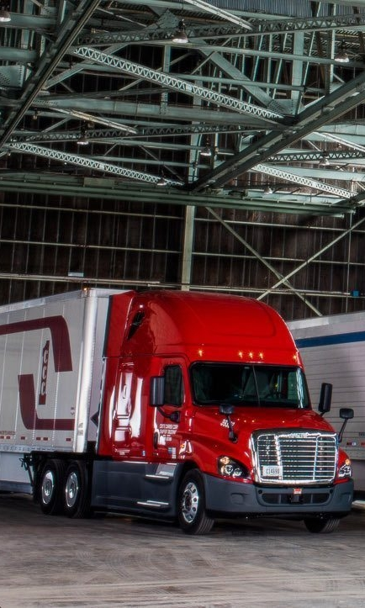
Crete Carrier Trucking & Logistics
Case Study
“
380 robots running more than 1 million robot executions yearly, automating 16,000 hours of work
50 percent of appointments are completely automated, with no need for human intervention
Notes:
Losing business because they didn’t know where their own trucks were – no visibility. (Crete or other?)
Published Case Study: http://www.kofax.com/learn/case-studies/davies-turner
In the past, order tracking was a reactive and manual process at Davies Turner. When the company received a customer query about an order, teams would have to visit the relevant carrier’s website and search their tracking systems for more information about the shipment. If a team member was unable to find this information online, they would have to contact the carrier by phone or email, incurring further delays. On average, it took around 10 to 15 minutes to respond to order tracking requests.
Using Kofax RPA, Davies Turner has built integration process flows (commonly referred to as software robots) that perform various data extraction and integration tasks that enable the company to offer customers alternative ways to communicate with them.
“To date, we’ve deployed close to 100 Kofax RPA robots,” Gurney noted. “We have found the solution to be incredibly user-friendly—you don’t need to be a developer to make use of it. At the same time, Kofax RPA is very powerful; the things it can do seem almost limitless. We are using the solution to integrate data from our own systems, partner systems and third-party websites, and there really doesn’t seem to be anything that Kofax RPA can’t integrate with!”
“With Kofax RPA, not only are we meeting customer’s expectations, we are exceeding them in certain areas. Normally a customer wouldn’t expect us to track all of their orders in real time, but thanks to Kofax RPA we now have this capability, increasing the number of shipments we track by 1000% without adding staff.”

Slide 36
Large European Bank
Case Study
Data gathering time cut significantly for critical processes
Customer Due Diligence (CDD) & Know Your Customer (KYC) investigations cut from 15 minutes to 30 seconds
Anti-Money Laundering investigations from 20 minutes to 2.5 minutes
Notes:
Published Case Study: http://www.kofax.com/learn/case-studies/robots-reduce-compliance-tasks-for-european-bank
A longstanding Kofax customer, the bank was already using a range of Kofax software across its business. Working with Kofax, the bank found an answer to its compliance challenges in an unexpected way.
The spokesperson said: “Kofax was presenting and demonstrating the Kofax TotalAgility Suite to our Document Logistics team, and they happened to touch on the topic of CDD and KYC. Kofax instantly recognized that their Kofax RPA offering could provide us with the perfect solution for these challenges. A few weeks later, we ran a proof-of-concept exercise, where we were able to see the capabilities of Kofax RPA first hand. This convinced us that the solution was an ideal fit for our needs.”
Thanks to Kofax RPA, the bank has been able to automate what were once time-consuming and error-prone CDD and KYC investigations. When analysts need to perform a check on a new customer, Kofax RPA robots will trawl the bank’s internal systems and databases, as well as external sources (such as Chamber of Commerce business registers, social media, news archives, Politically Exposed Persons (PEP) databases, and more) to verify the customer’s identity and determine if they have been linked to any illicit activity.
“We perform upwards of 2,800 CDD and KYC investigations every week, so the efficiency gains that we have achieved with Kofax RPA mean that we are saving thousands of person-hours of work a week.

Slide 37

Notes:
https://upload.wikimedia.org/wikipedia/commons/e/e0/Scan_MRI.jpg

Slide 38

Notes:
https://commons.wikimedia.org/wiki/File:Champagne_bottles_in_a_bucket_-_8439.jpg
SUPPLIER in Irelands supplies to Hotels and Conference Centers.
If they are unable to deliver then need to cancel orders in system A and inform customers that they cannot deliver.
If the champagne supplier cannot deliver them a crate of champagne, they have to cancel champagne orders to hotels and weddings.
Each bottle required 20 clicks in the software.
This is also a CCM possibility of sending a beautiful personlaized email to a customer with a voucherdiscount to buy an alternative
Champagne today. So the robot could turn a bad situation into a happier customer.

Slide 39
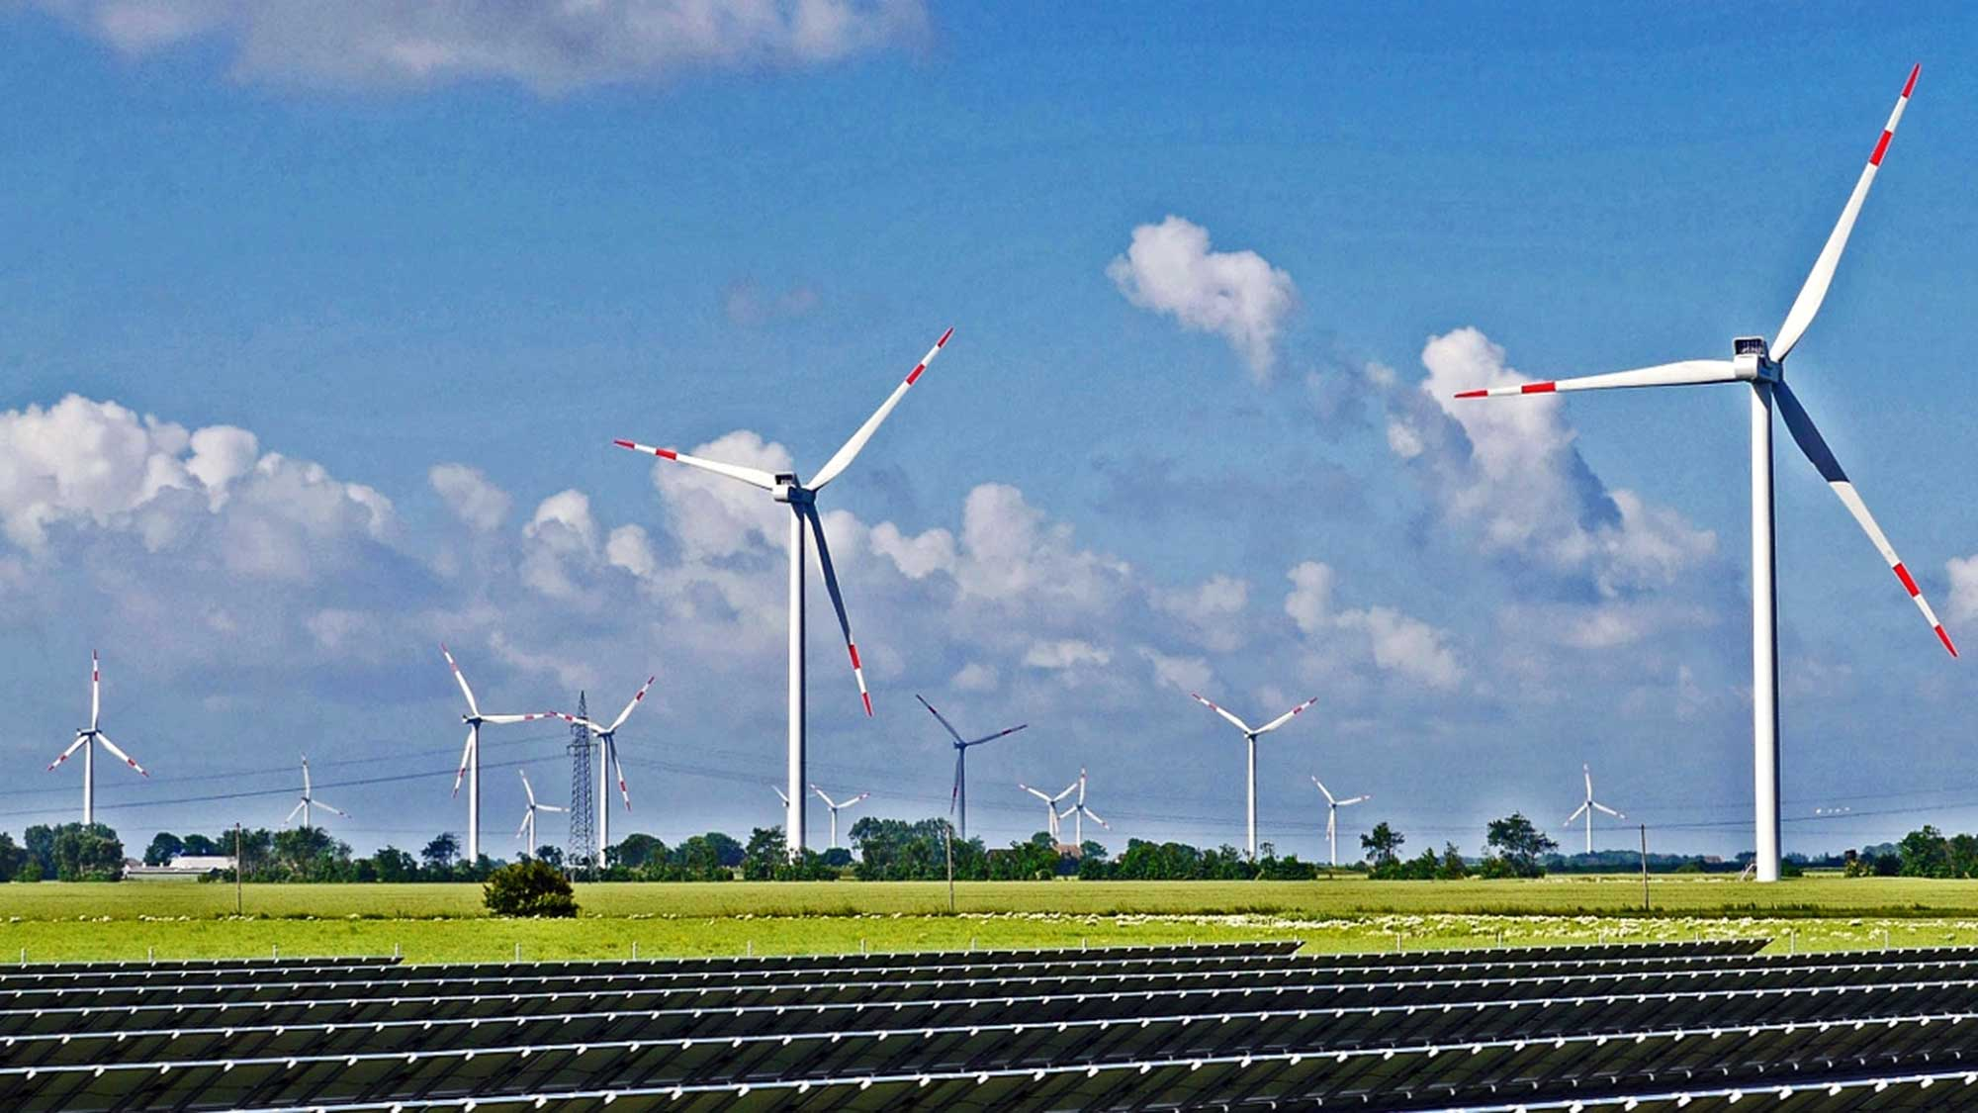
Notes:
https://upload.wikimedia.org/wikipedia/commons/3/32/Renewable_energy_park.jpg
Energy brokerage.
A Kofax RPA customer (1 man) uses RPA robots to see what every wind turbine, tide, solar panel in Europe is doing today and yesterday. He has his own visualization and analytics software and sells this information to electricity providers who want to know where to buy electricity form in 5 minutes, 20 minutes and 1 hour.
Kapow is a powerful tool for finding and selling information.

Slide 40


Why PDFs?
Businesses are sending PDFs to each other
US insurance company transfer 100’s of patients/pdf to each other every day.
Many companies are sending data to each other via pdf. Someone is copying this into Excel…
Global Logistics Companies send 200+ page pdfs between departments constantly.
PDF is a data transfer mechanism between companies

Slide 41
RPA Market

Slide 42







Use Cases
Web Data Extraction
Automate Manual Business Process Activities
Banking
Banking
Logistics
Manufacturing
Equity research
Compliance and risk management
Mortgage lending
Compliance reporting
Customer service
Order scheduling and tracking
Invoicing & credit collections
Researching loads
Supply chain automation
Information & Services Provider
Cross-Industry
Healthcare
Insurance
Data aggregation
Screening and risk management services
Finance and accounting
Sales operations
Patient eligibility
Physician credentialing
Customer service
Claims processing
Compliance reporting
Customer service
Retail, Travel
Competitive intelligence and price monitoring
Brand monitoring and fraud protection
Notes:
There are several business use cases in which Kofax RPA is being used today. We’ve broken the use cases into two categories – web data extraction and the automation of process activities.
Some common use case examples for web data extraction include organizations needing to monitor competitors and pricing, and investment banking equity research teams who rely on the collection of data from web sites to help facilitate in-depth research and analysis of companies, industries, markets, and world economies.
In the case of software robots automating manual repetitive activities, Kofax RPA excels at virtually any multi-step business tasks across multiple systems both internally and externally. As we described earlier, this is commonly referred to as robotic process automation and is applicable to several industries and business departments including banking, insurance, transportation and logistics, manufacturing, and healthcare. For example, in transportation and logistics Kofax RPA helps eliminate costly manual activities by integrating and automating processes involving the exchange of data between their internal systems and third party portals involving shippers, carriers, freight bill payment processors, and other partners.
Back office finance and accounting operations including shared services groups are also a good fit for Kofax RPA including business activities like posting invoices into a supplier portal, researching payment collection issues, and financial closing tasks are just a few examples.
Take a few minutes to familiarize yourself with the different Kofax RPA use cases.
Let’s now look at a few customer examples that show Kofax RPA is being used and the benefits customers are achieving.

Slide 43
Which Finance processes are suitable to deploy with RPA?
Transaction processing
External reporting
Record to report (general accounting)
Purchase to payment
Order to cash
General Ledger
Accounting
Consolidations
Monthly/ Quarterly Close
Financial Reconciliation
Requisition Materials
Purchasing/ Procurement
Order Entry
Billing
Legal Entity Reporting
Statutory Reporting
Fixed Asset Accounting
Tax Planning/ Accounting
Benefits Admin./ Accounting
Inquiry Handling
Payment Processing
Accounts Payable
Cash Application
Collections
Regulatory Reporting
Rating Agency Relations
Premium Accounting (Ins)
Re-insurance Accounting (Ins)
Investment Accounting/ Securities Pricing (FS)
Daily P&L/ Mark to Market/ Middle Office
T&E
Accounting/ Reimburse-ment
Procurement. Card Admin
Bank Reconciliation
Treasury/ Trust Management
Investor Relations
Business decision support
Finance management
Planning
Control
Strategic Planning
Budgeting & Financial Planning
Forecasting
Accounting/ Tax Policy
Internal Audit
Financial Analysis
Internal Consulting
Project Management
Finance Function Management
Human Performance Management
Business Liaison
Training & Development
Management reporting
Specialized expertise
Expense/ Revenue Allocations
Performance Measure-ments
Multi-Dimensional Reporting
Profit Center/ Customer/ Producer Profitability
Acquisitions & Divestitures
Risk Management (CM)
Actuarial Analysis/ Reserving (Ins)
Real Estate Mgmt.
Opportunities for Automation
Low
Medium
High

Slide 44
Which HR processes are suitable to deploy with RPA?
Shared Services typically offer a good range for automation solutions
Talents
HR Operations & Support
HR Strategy
HR Steering
Talent
Customer Services
Documents Mgmt.
Human Capital Strategy
Strategic Workforce Planning
Governance
Organizational Design
Competency Framework
Contact / Inquiry
Portal/ Knowledge Mgmt.
Physical Records
Document Management
HR Strategy
Metrics & Analytics
Employer Branding
HR Services & Administration
Employee Services
Talent Life-Cycle
Employee Relations
Discipline & Grievance
Mobility Services
Leave Management
Sourcing
Deployment
Performance
HR Development
Rewards
Talent Sourcing
Workforce Planning
Competency Management
Compensation
Absence Management
Health & Safety
Exit Management
Labor Relations
Executive Development
Recruiting
Career Pathing
Objective Setting
Learning
Benefits
Payroll and Administration
Master Data Management
Compensation Admin.
Pension Administration
Transfers
Succession Planning
Performance Management
Knowledge Management
Pensions
Organizational Design
Benefits Administration
HR Payroll
Contingent Staffing
Workforce Scheduling
Performance Support
Recognition
Opportunities for Automation
Low
Medium
High

Slide 45
Which Supply Chain processes are suitable to deploy with RPA?
Plan
Source
Deliver
Perform Demand Planning
Perform Sourcing Strategy
Operational Procurement
Process Orders
Manage Transportation
Enterprise Forecasting
Demand Sensing
Define Sourcing Strategy by Commodity
Conduct RFx/Auctions and Optimize Bid
Create Requisition and Obtain Approval
Transfer Product
Process Inquiry and Quote
Release and Consolidate Orders
Build Loads
Deliver Product to Customer
Customer Collaboration
Analyze Supply and Assess Opportunity
Negotiate Contract
Create Purchase Order
Asses Impact of Product
Receive, Enter & Validate Order
Generate Invoice and Collect Payment
Route Shipments
Manage Import/Export and Customers
Perform Integrated Business Planning (Sales & Operations Planning)
Analyze Supply Market and Qualify Suppliers
Select and Activate Supplier
Receive and Verify Product
Authorize Supplier Payment
Check for Inventory Availability
Process Complaints and Inquiries
Select, Rate and Schedule Shipments
Manage Transportation Assets
New Product Development
Conduct Financial Reconciliation
Reserve Inventory & Determine Delivery Date
Load Vehicle and Generate Shipping Docs
Manage Freight Pay and Audit Process
Perform Sourcing Strategy
Segment Suppliers
Measure and Drive Performance
Conduct Supplier Reviews
Terminate / Transition Suppliers
Conduct Supply Balancing
Manage Warehousing
Process Returns
Terminate / Transition Suppliers
Track Continuous Improvement
Receive Product from Source (Supplier)
Pick Product
Perform Returns Planning
Execute Processing of Returns, Repairs and Recalls
Perform Inventory Planning
Track Product Lots and Batches
Plan and Manage Inventory
Manage Contracts
Pack and Label Shipment
Manage Warehouse Operations
Manage Returns Policies and Procedures
Create Contract
Monitor and Enforce Contracts
Perform Inventory Control
Opportunities for Automation
Low
Medium
High

Slide 46
Measuring

Slide 47


RPA Prioritization Matrix
Low Complexity High Benefits
Quick ROI
High Complexity High Benefits
Consider Process Optimization
1. Quick wins
2. Too complex, break it down
Value/Benefits/ROI
Low Complexity Low Benefits
Do when project cost is lower
High Complexity
Low Benefits
Poor ROI
3. Do it much later
4. Requires human cognition
Complexity Low (routine, automatable) →High (difficult, exception, need humans)

Slide 48
Value/Benefits
Human
Minutes/day, minutes/role, people/day (FTE), role/day
Number/day
Minutes/person, increase human capacity
(Response/Elapsed) time/customer
Staff health/happiness/turnover
Business
Dollars/day
Mistakes/case
Penalties/avoided
Customers won/lost/complaints/delay
Days Sales Outstanding (DSO)
IT
Serverload saved
3rd party licenses saved

Slide 49
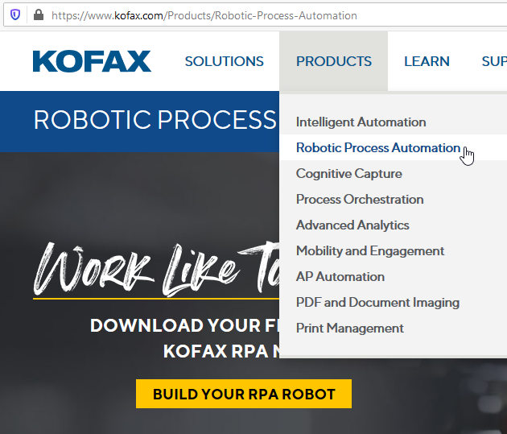
Download and Build your own robot now for free

